Slide 1

ProfitLens: Visualizing E-Commerce Trends
Understanding which products, regions, and discount strategies drive the highest profitability through data-driven insights.

Slide 2

The Business Challenge
Our Mission
Why It Matters
Analyze e-commerce data from Kaggle to uncover how products, regions, and discounts impact sales and profit. Discover which business areas generate the most revenue and enable smarter, data-driven decisions.
Companies need clear insights into profitability drivers to optimize strategies, reduce waste, and maximize returns across categories and regions.

Slide 3
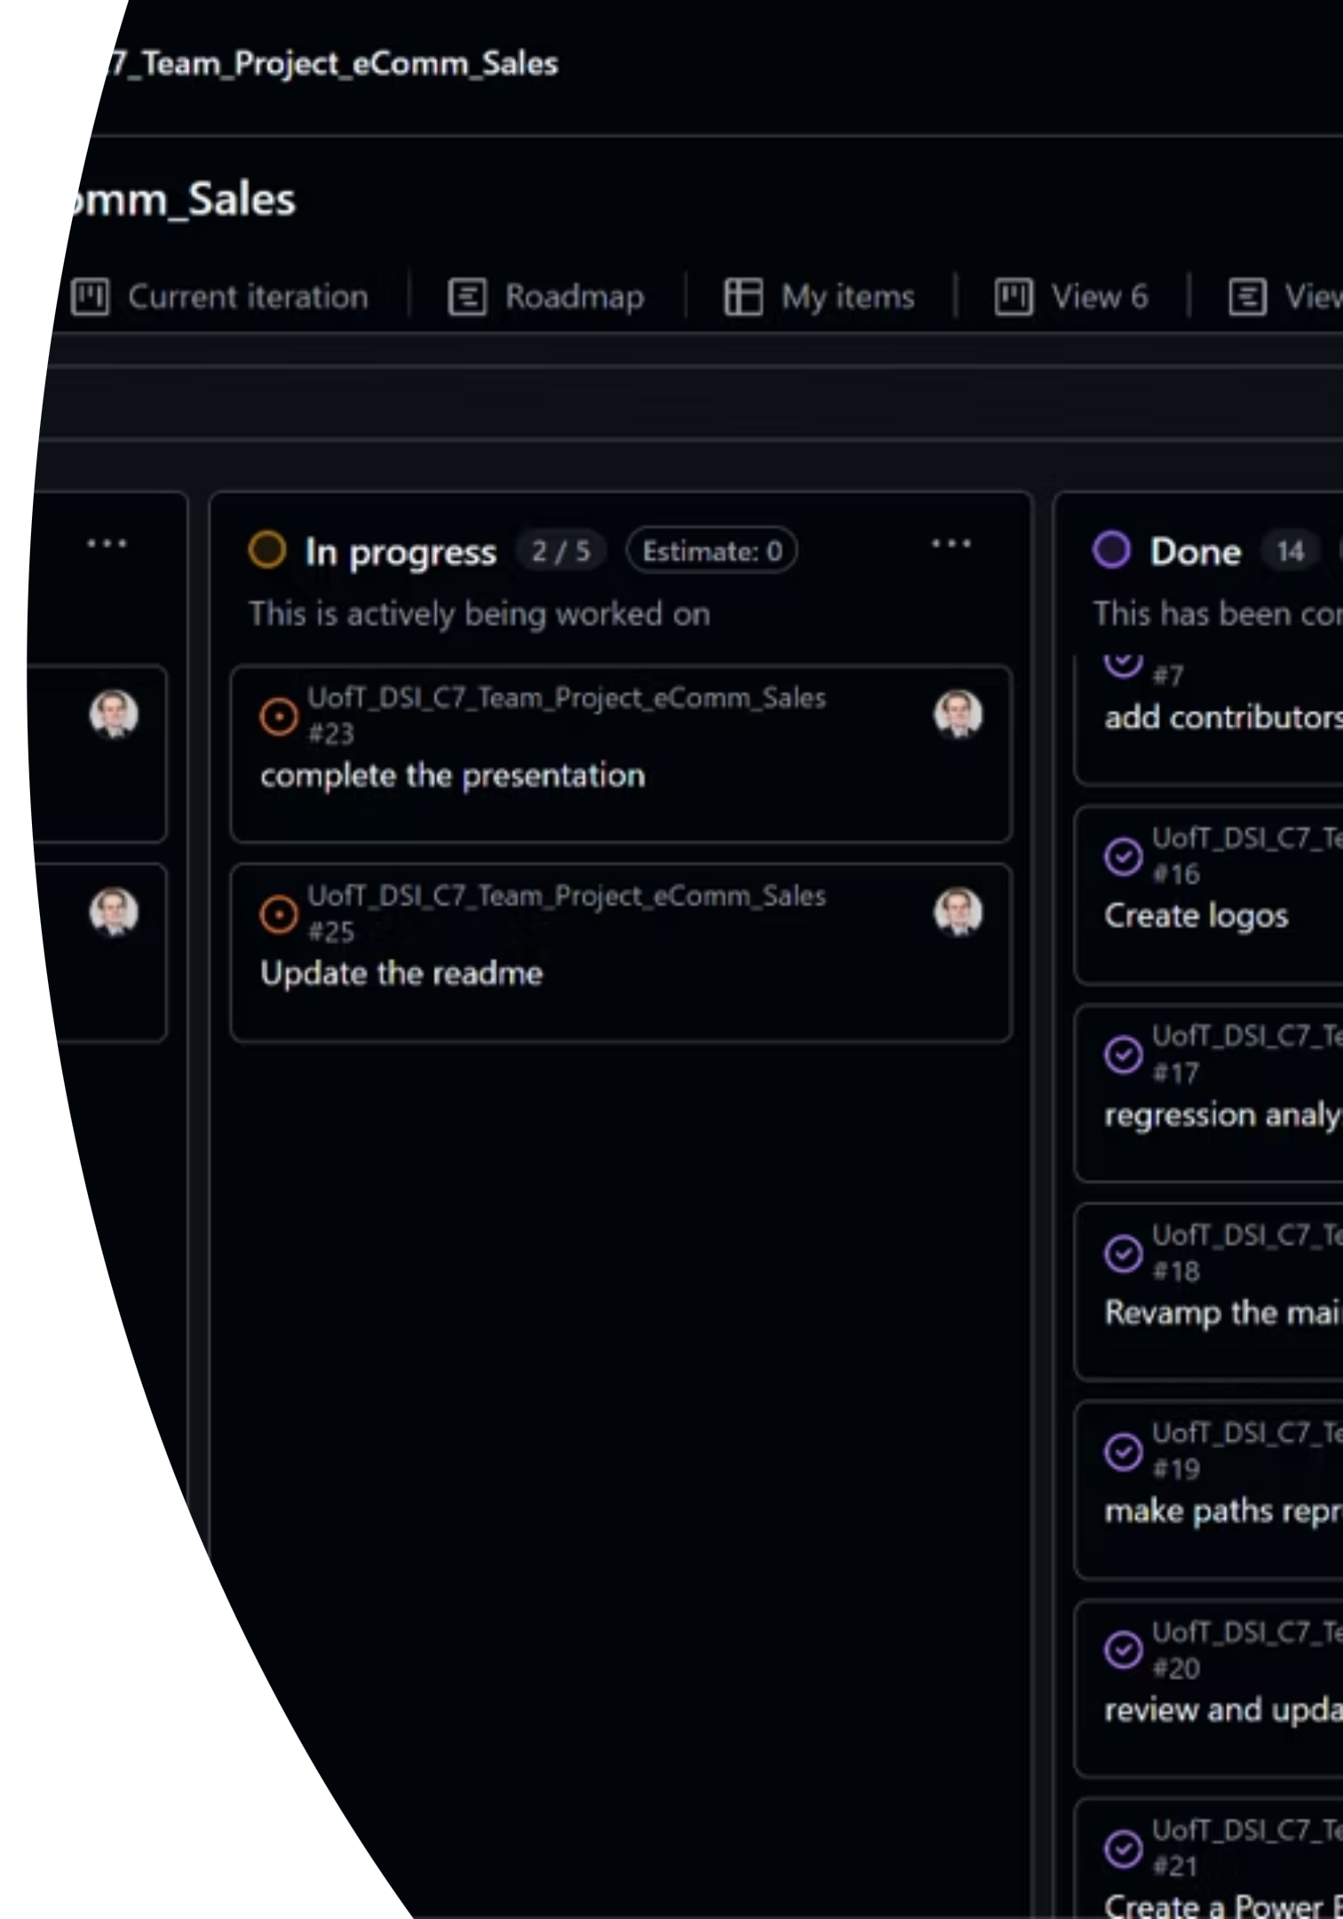






Project Objectives
Data Preparation
Pattern Discovery
Clean and organize raw data
Identify sales, profit, and discount relationships
Profitability Analysis
Visual Insights
Spot most profitable categories/regions
Communicate results with clear charts
Predictive Modeling
Forecast future profit and sales

Slide 4



Team & Responsibilities
Vikrama
Iryna
Paul
Business proposal development, project naming, data cleaning, experiments, and code review
Dataset selection, data exploration, KPI development, and setting business goals
Repository management, project tracking, data exploration and cleaning, slides, visualization, and presentation management

Slide 5




Key Data Parameters
1
2
Price
Product Quantity
Pricing & revenue
Volume & inventory
3
4
State
Repeat orders
Regional performance
Driving returning customers
5
Date
Temporal trends

Slide 6

Data Cleaning Strategy
Essential Steps
Data Enhancement
Remove unnecessary columns (index, promotion-ids)
Check and remove duplicate Order IDs
Group similar order statuses for consistency
Handle missing values in Courier Status, currency, Amount, ship-city, ship-state
Ensure currency consistency (convert to INR)
Convert Date to proper format for time-based analysis
Add derived columns: Profit Margin, Month/Year extractions
Standardize text formats to lowercase

Slide 7
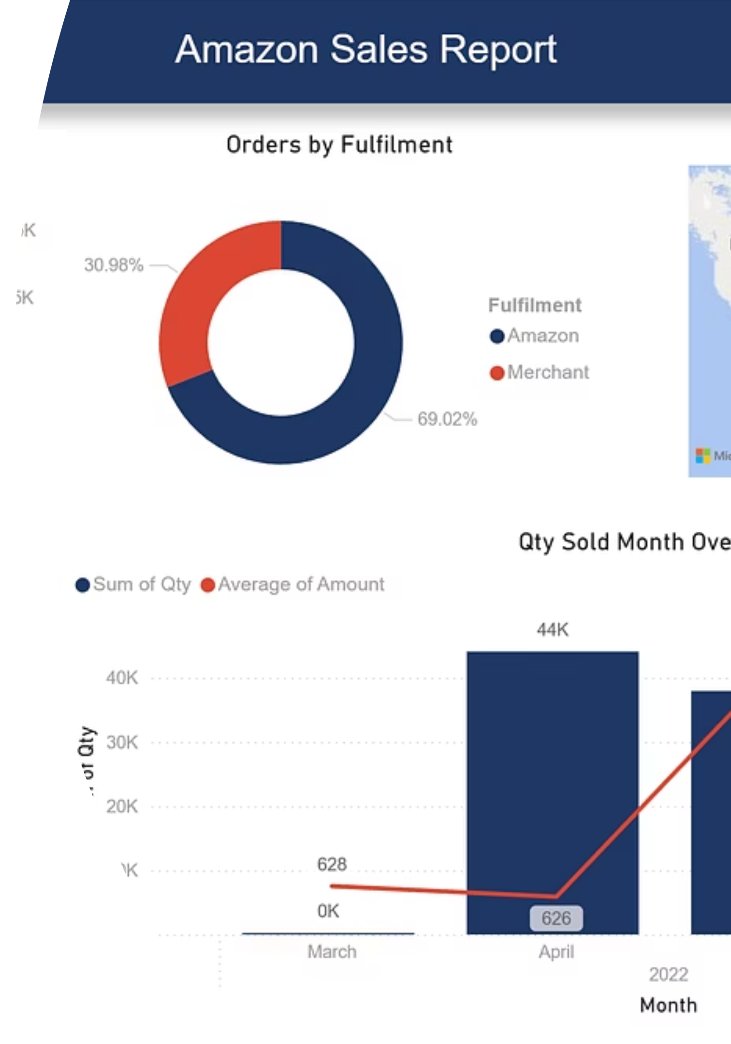




Analysis Focus Areas
Product Insights
Top selling and highest revenue categories
Regional Insights
Most profitable states and cities
Order Performance
Amazon vs Merchant fulfillment comparison
Sales Patterns
Impact of discounts, promotions and repeat orders

Slide 8
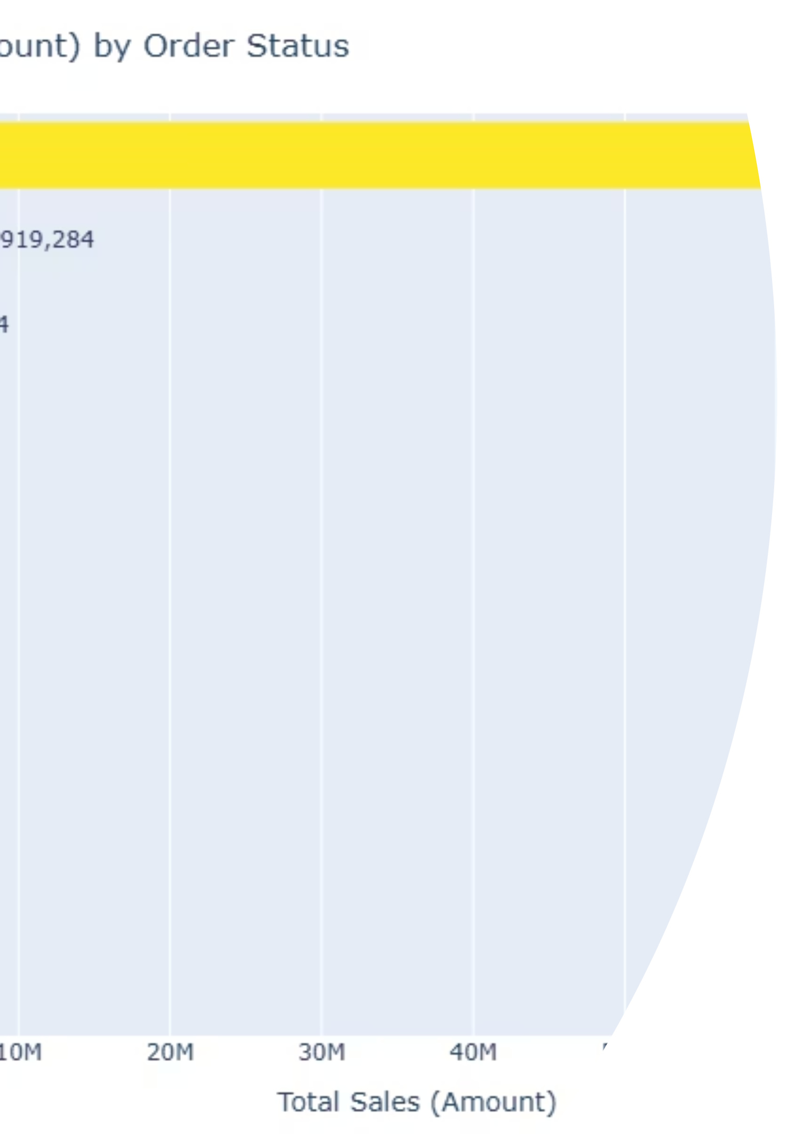
Visualizations
Plotly, Seaborn, Matplotlib: Compare product performance across types.
Power BI: Track shipped, cancelled, and pending orders.
Monthly Sales Trends: Identify seasonal spikes and patterns.
Correlation Heatmap: Understand relationships between sales, quantity, and discounts.

Slide 9



Risks & Challenges
Profit Margin Calculation
Cost Data Gaps
Lack of cost and Bill of Materials (BOM) data restricts deeper financial analysis
No clear methodology to calculate profit margins given current dataset limitations
Time Constraints
PM methodology
Limited project timeline requires prioritization of key deliverables and analysis
GitHub Project used with agile methods.

Slide 10


Expected Outcomes
01
02
Clean Dataset
Profitability Insights
Organized, standardized data
Identify key profit drivers
03
04
Visual Dashboard
Predictive Model
Interactive data insights
Future sales forecasting
05
06
Actionable Recommendations
Bonus
UofT color schemes for Excel and Power BI (available in readme)
Data-driven strategies for growth

